Slide 1

Developing Management Skills
Managing Conflict

Slide 2
Learning Objectives
Diagnose the focus and source of conflicts
Utilize appropriate conflict management strategies
Resolve interpersonal confrontations through collaborations

Slide 3
The Relationship Between Conflict and Outcomes
Organizational Outcomes
Positive
Negative
Low
High
Level of Conflict

Slide 4
Rules of Engagement
Work with more information
Focus on the facts
Develop multiple alternatives
Share agreed-upon goals
Inject humor
Maintain a balanced power structure
Resolve issues without forcing consensus

Slide 5
Types of Conflict
Focus of Conflict
Issues
People
Source of Conflict
Personal Differences
Informational Differences
Incompatible Roles
Environmental Stress

Slide 6
Conflict Focus
  People-focused: “In-your-face” confrontations in which emotions are fueled by moral indignation
  Issue-focused: negotiations in which participants agree how to allocate scarce resources

Slide 7

Four Sources of Interpersonal Conflict
Personal Differences: Conflicts stem from personal values and needs

Slide 8

Four Sources of Interpersonal Conflict
Informational Deficiencies: Conflicts evolve from misinformation and misunderstanding

Slide 9

Four Sources of Interpersonal Conflict
Role Incompatibility: Conflicts evolve from the perception that assigned goals and responsibilities compete with those of others.

Slide 10

Four Sources of Interpersonal Conflict
Environmentally Induced Stress: Conflict results from the stressful events of the organizational environment.

Slide 11
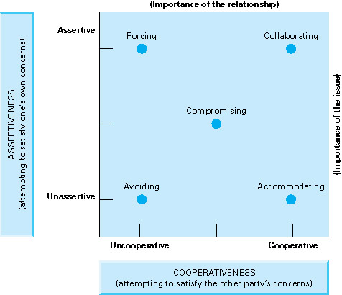
Conflict Resolution
Insert figure 7.3

Slide 12

Forcing
Satisfy personal needs at the expense of the other person
Formal authority, bullying, manipulation, etc.
Outcome: You feel vindicated; other person feels defeated

Slide 13

Avoiding
Neglect interests of both parties by sidestepping or postponing
Reflects inability to handle emotion of conflict
Outcome: Nothing (or things get worse)

Slide 14

Accommodating
Satisfy other party’s concerns but neglect your own
Preserve a relationship at the expense of genuine appraisal of issues
Outcome: Other person takes advantage of you; decreased power and credibility

Slide 15

Compromising
Seek partial satisfaction for both parties
Expedient, not effective, solutions
Outcome: Gamesmanship and suboptimal resolutions

Slide 16
Collaborating
Seek to address concerns of both parties
No assignment of blame
Outcome: When collaborating is possible, problem likely to be resolved

Slide 17
Selecting the Right Strategy
Two Perspectives on Negotiation:
Distributive: “Dividing up a fixed pie”
Integrative: “Expanding the pie”

Slide 18

While we are predisposed to one approach, no single approach is the best. Effective managers use a variety of approaches

Slide 19
Situational Considerations
Select your conflict management approach based upon:
Issue importance
Relationship importance
Relative power
Time constraints

Slide 20
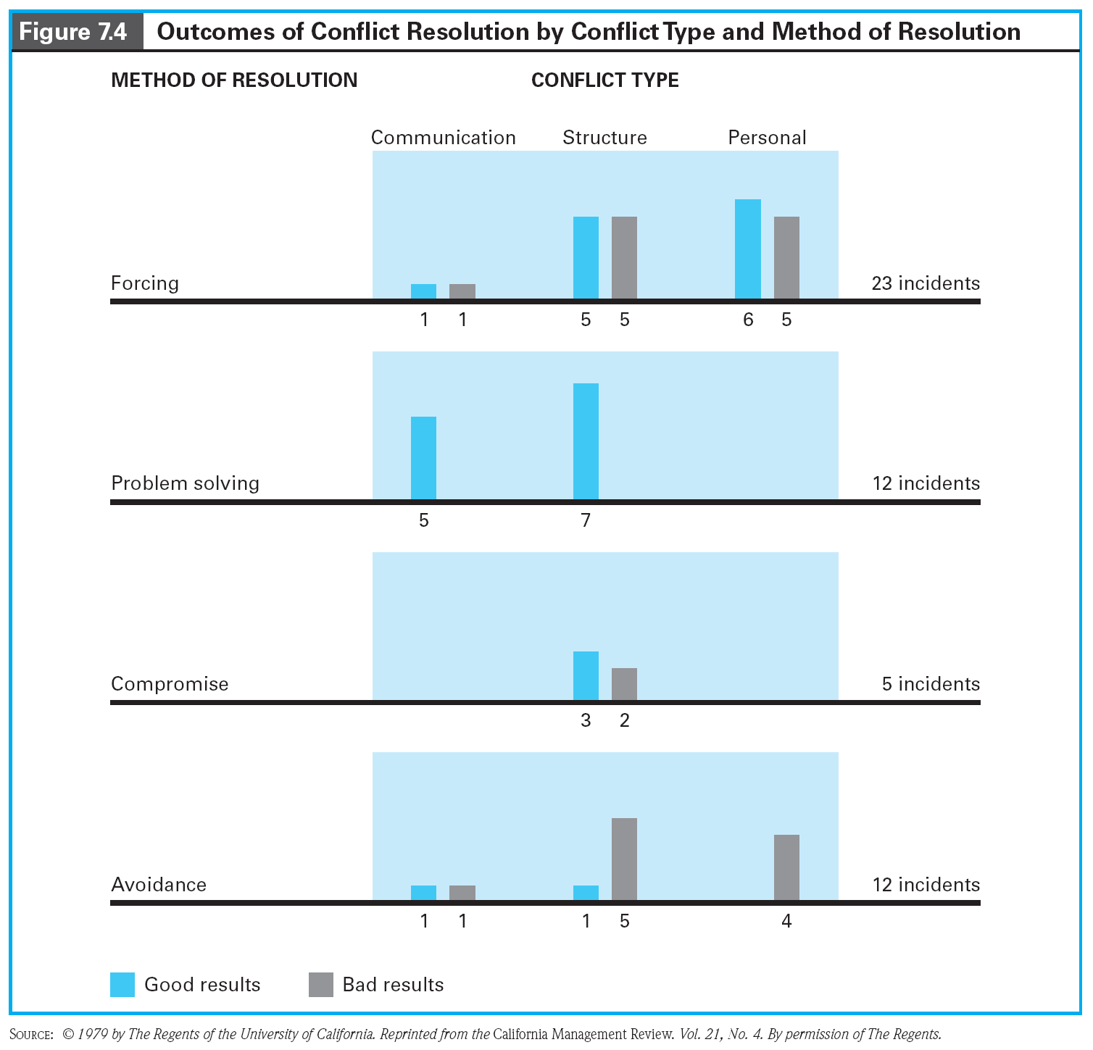
Conflict Resolution Outcomes by Type and Method

Slide 21

A ‘Default Strategy’
Of all the approaches, collaboration is the best. However, it is also the most difficult to implement.

Slide 22
Framework for Collaborative Problem Solving
Establish superordinate goals
Separate the people from the problem
Focus on interests, not positions

Slide 23
Framework for Collaborative Problem Solving (con’t)
Invent options for mutual gains
Use objective criteria for evaluating alternatives
Define success in terms of real gains, not imaginary losses

Slide 24
Four Phases of Collaborative Problem Solving
Problem Identification
Solution Generation
Action Plan Formulation and Agreement
Implementation and Follow-Up

Slide 25
Phase 1:
Problem Identification
Initiator
Maintain personal ownership of problem
Describe problem in terms of behaviors, consequences, and feelings
Avoid drawing conclusions and attributing motives
Persist until understood
Encourage two-way discussion

Slide 26
Phase 1:
Problem Identification
Responder
Establish a climate for joint problem solving
Seek additional information by asking questions
Agree with some aspect of the complaint

Slide 27
Phase 1:
Problem Identification
Mediator’s Role
Establish a problem solving framework
Maintain a neutral posture regarding the disputants
Serve as facilitator, not judge
Insure discussion to ensure fairness

Slide 28

Phase 2:
Solution Generation
Initiator
Focus on commonalities as the basis for requesting a change

Slide 29

Phase 2:
Solution Generation
Responder
Ask for suggestions of acceptable alternatives

Slide 30

Phase 2:
Solution Generation
Mediator
Explore options by focusing on interests; create agreement on action plan and follow-up

Slide 31
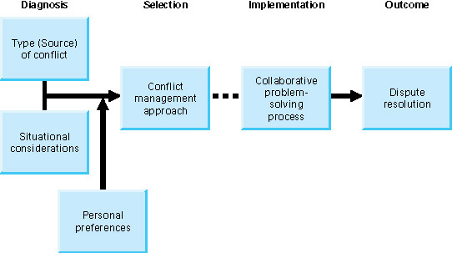
Summary Model of Conflict Management
Insert figure 7.6

Slide 32
Behavioral Guidelines
Collect information on the sources of conflict
Examine relevant situational considerations

Slide 33
Behavioral Guidelines
Take into consideration your personal preferences for using the conflict management approaches
Utilize the collaborative approach unless conditions dictate the use of an alterative approach

